Slide 1
QA SIMULATION PROJECT
Nithya Viswanathan
Sekar Gayathri
Lauri Kyttälä
Suman Basnet

Slide 2
SMART-SENSOR Mobile TESTING
Requirement

Slide 3
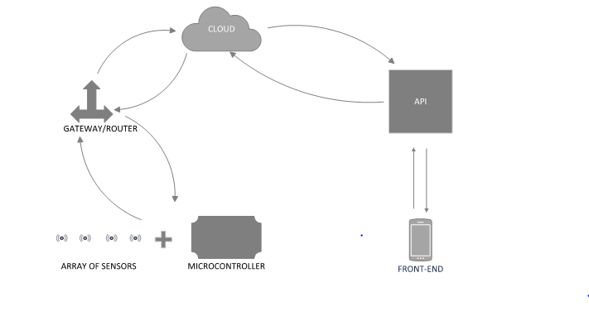
SMART-SENSOR Mobile TESTING
Test Methodology :: Agile Method
Test Modules
MODULE 1 :: SmartSensor ---------- Cloud
SUB-MODULE 1 :: SmartSensor
SUB-MODULE 2 :: SmartSensor to Gateway
SUB-MODULE 3 :: Gateway to Cloud
MODULE 2 :: Cloud ---------- Mobile / Desktop
SUB-MODULE 4 :: Cloud to API
SUB-MODULE 5 :: API to End User

Slide 4
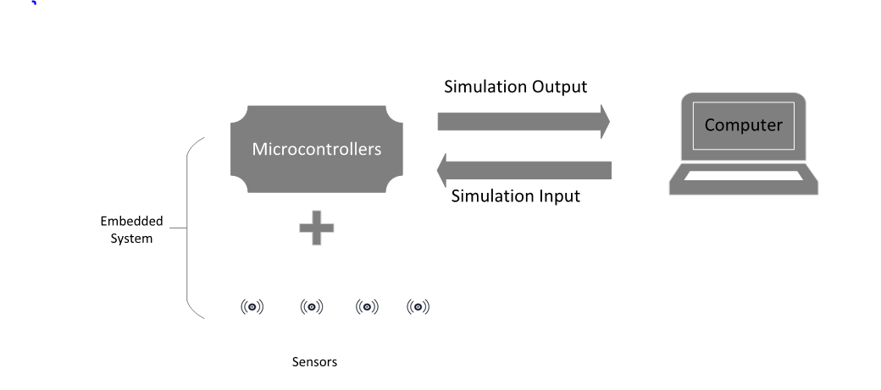
MODULE 1 :: SmartSensor ---------- Cloud SUB-MODULE 1 :: SmartSensor Test Environment
Test levels
Usability testing (easy for end user)
Security testing (To test the data is encrypted)
Functionality (High level)
Tools :: WireShark, Jodan

Slide 5
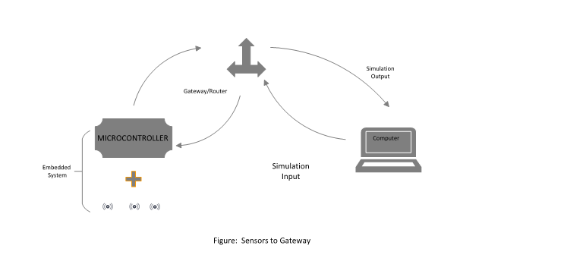
SUB-MODULE 2 :: SENSOR to Gateway
TEST ENVIORNMENT
Test level ::
Network testing (connectivity)
Security testing (Encrypted data)
Performance testing (supports multiple sensor / 24 x7)
Compatibility testing (Between sensor and Gateway)
Tools :: Spirent (to trigger packet and check authenticity) Automation :: Network testing, Performance testing

Slide 6
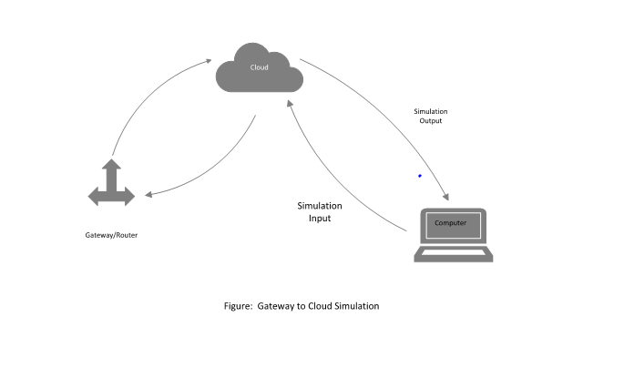
SUB-MODULE 3 :: Gateway to Cloud
TEST ENVIRONMENT
TEST levels
Network testing (Connectivity)
Performance testing (multiple sensor / 24 x7)
Security testing (MQTT)
Stability testing (Load)
Tools :: Spirent (to trigger packet and check authenticity)

Slide 7
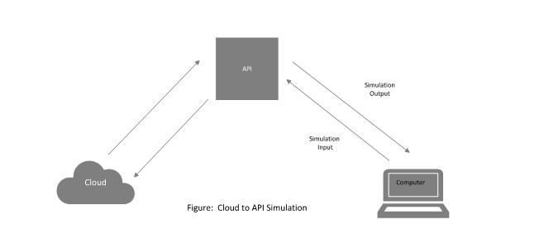
MODULE 2 :: Cloud ---------- Mobile / Desktop SUB-MODULE 4 :: Cloud to API
TEST ENVIRONMENT
TEST level::
Functionality (Decryption data, Error handling, Parameters tested, Negative testing)
Performance testing (Load, Scalability, Stress)
Test tools :: Jmeter
Automation :: Functionality , Performance testing

Slide 8
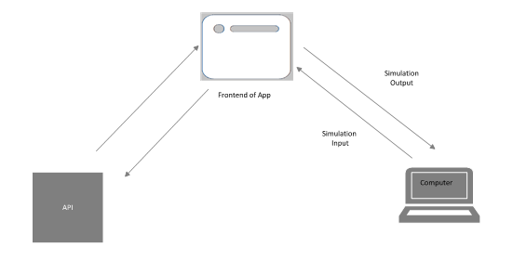
SUB-MODULE 5 :: API to Mobile
TEST ENVIRONMENT
TEST levels
Functionality (UI, Trigger Alert)
Performance testing (load, scalability, Stress)
Compatibility(Android/iOS),Usability,
Test tools::Jmeter for performance testing , PostMan for functionality testing, BURP for security testing
Automation :: Functionality, Performance (More focus)

Slide 9
SmartSensor to End User (End-to-End testing)
TEST levels
End to End complete system testing (Performance)
Test tools::Jmeter for performance testing
Automation :: Performance
At the end will do a Pilot testing before handling it to the Stakeholders!

Slide 10
Test Automation
Automation tools:: Robot Framework, Jmeter, PostMan, BURB
TEST bugs handled by JIRA

Slide 11
THANK YOU! Q & A ????

